Slide 1
WatchDog Topology
Chris Kyriacou / CFN Services Ltd © 10th July 2026

Slide 2
Tech Stack for WatchDog Alpha (working prototype, July 2026)
Hardware stack:
ESP32 microcontroller dev kits, ESP32-S3, ESP32-C3, Wroom32D, Wrover-E
Programmed with ESP-IDF v6.x via VSCode IDE
Software stack:
Docker Desktop v4.82 (latest stable)
Python v3.12
Postgres v18
Streamlit (v1.59.2)
Grafana (latest stable) – may not be used (was only for charting)
FastAPI v0.139.2 (latest stable)
Microsoft Windows 11 Pro, VSCode and WSL (for Docker Desktop/Containers)

Slide 3
Hardware
Root Node - a device capable of having sensor modules installed, but crucially acts as a bridge or router via WLAN, LoRa, LTE etc to provide Internet Connectivity. Acts as an ESP-Mesh “root” and typically there is a single Root Node per deployed solution. Root Nodes are often referred to as “gateways”
Sensor Node – a device capable of having sensor modules installed to periodically sample the sensors at a user configurable interval, collect data and transmit to the Root Node to buffer and forward to the cloud based database and front end management and reporting tool
Power Efficiency – Root Nodes and Sensor Node hardware are primarily powered using Lithium ion/Polymer batteries, so power efficiency and battery life is a top priority

Slide 4
Software
Frontend – Streamlit GUI to provide user management, device management, device configuration, OTA update administration and dashboard/reporting capabilities
API – FastAPI provides API services to knit the solution together, from ingesting sensor data to handling all calls to the database
DB – Postgres provides simple database functionality and storage of user data, sensor data, firmware updates, device configuration data and data backups
Grafana – initially used to visualise sensor data submitted to the database, it is unlikely to be used moving forwards

Slide 5
Sensor Node Capabilities
Sensor Nodes use plug and play Sensor Modules
Sensor Modules typically use i2c communication, but may also take advantage of ADC, DAC and GPIO pins on ESP32 MCUs
Intended to be battery powered so physically small, discrete and highly portable, able to be installed with Velcro to surfaces
Sensor Module examples (non-exhaustive):
Flood Detection
Temp and Humidity sampling
Light/Luminance sampling
Motion/Presence detection
Hall Effect sensors (to detect door or window opening events)
Still image capture/Video streaming
Sound Detection, recording/streaming
Air quality sampling (particulate matter)

Slide 6
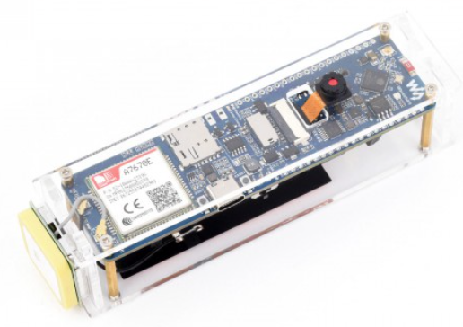
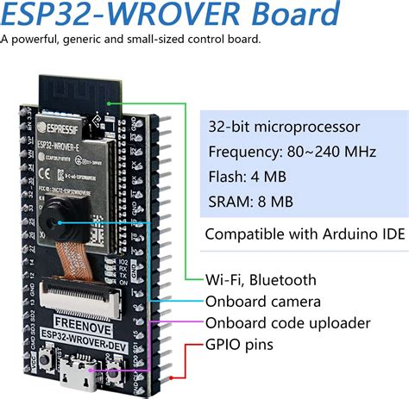
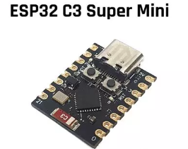
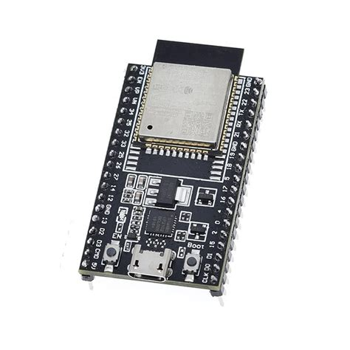
Root/Sensor Hardware ESP-Mesh Topology (Example)
Root Layer
(Mesh and Internet/LAN connected; uplinks to
LAN/Cloud, downlinks to Parent and Child devices)
ROOT-NODE: Waveshare ESP32-S3 A7670E 4G Dev Board, with: LTE Cat-1, 2G, WiFi, Bluetooth, SMS & GNSS GPS
Parent & Child Layer
(Mesh Child Uplinks to
Root & Downlinks to
Children below)
160mhz RISC V, 4MB Flash
Child Layer
(Mesh Uplinks to
Parent devices, no
further Downlinks)
ESP32-Wroom DevKitC
ESP32-Wroom DevKitC

Slide 7



Software Topology (July 2026)

Slide 8
WatchDog Features
Can be run as a Cloud SaaS service or local install (via Docker)
Can be resold by 3rd parties
Root and Sensor Nodes can be manually deployed or quick deployed via QR code for fast configuration
Root and Sensor Nodes can be physically installed with minimal work (self adhesive Velcro) or small self tapping screw
Primary power source is batteries LiOn or LiPo, but can also use 5v DC via USB
Root Node internet connectivity can be achieved via WLAN, Bluetooth, LTE, LoRa and other options
ESP self-healing Mesh supported for hardware devices
Low cost
Multi-tenanted, many users can provision their own users, reports, devices and sites securely and with privacy
End to End Encryption, for data security, packet security and Node hardware firmware security

